Slide 1
West-Wide Governance Pathways Initiative
NV Regional Transmission Coordination Task Force
June 24, 2024

Slide 2
Pathways Initiative Background

Slide 3
Launch Committee Members
States/Provinces:
Commissioner Milt Doumit, WA
Commissioner Kevin Thompson, AZ
President Alice Reynolds, CA
Alternates:
Letha Tawney, OR
Siva Gunda, CA
Pat O’Connell, NM
CA IOU Transmission Owners:
Scott Ranzal, PG&E
Jeff Nelson, SCE
EIM Entities:
Alyssa Koslow, APS
David Rubin, NVE
Kerstin Rock, PAC
Pam Sporborg, PGE
Alternate:
Robert Eckenrod, PAC
Labor:
Marc Joseph, IBEW – CA
Public Power and Coops:
Josh Walter, SCL
Connor Reiten, PNGC
Jim Shetler, BANC
Randy Howard, NCPA
Alternate:
Jon Olson, SMUD
Independent Power Producers:
Scott Miller, WPTF
Jan Smutny-Jones, IEPA
Ben Fitch-Fleischmann, Interwest
Alternates:
Spencer Gray, NIPPC
Lisa Tormoen Hickey, Interwest
Residential and Small Commercial Customers:
Michele Beck, Utah Office of Consumer Services
Non-utility Load Serving Entities:
Evelyn Kahl, CalCCA
Large C&I Customers:
Kathleen Staks, Western Freedom Alternate:
Heidi Ratz, CEBA
Technology Providers:
Brian Turner, AEU
Public Interest Organizations: Michael Colvin, EDF
Alaine Ginocchio, WRA
Ben Otto, NW Energy Coalition
Alternate:
Mark Specht, UCS
Power Marketing Authorities: Chrystal Dean, WAPA

Slide 4
Launch Committee Mission
The Mission of the Launch Committee of the WWGPI (Committee) is to develop and form a new and independent entity with an independent governance structure that is capable of overseeing an expansive suite of West-wide wholesale electricity markets and related functions based on the following core principles:
The entity should enable the largest footprint possible that includes California, and maximizes overall consumer benefits;
The entity will include independent governance for all market operations;
The new entity will preserve and build upon existing CAISO market structures that serve over 80% of the Western Interconnection, including the Western Energy Imbalance Market (WEIM) and the Extended Day Ahead Market (EDAM);
A primary goal will be to minimize duplication and incurrence of costs for both the market operator and market participants; and
The structure should be flexible to accommodate the future voluntary provisions of full regional transmission organization (RTO) services for those entities that desire to do so, but not mandate that any entity must join such a future potential RTO.

Slide 5
Evaluation Criteria
1. Maximized net benefits, including reliability, affordability and environmental benefits, recognizing startup and ongoing costs, and considering both new benefits and impacts on existing benefits.
2. Equitable representation across the Western region and among all market participants, including for a wide range of legal entities.
3. A governance structure independent of any single state, participant, or class of participants.
4. Organizational flexibility to accommodate future expansion of regional solutions and to create a credible and timely path to a voluntary RTO, including the balancing authority and transmission planning functions.
5. Optionality to allow market participants to choose the market services they value.
6. Preservation of existing balancing authorities’ ability to maintain independence, authority, and governance.
7. An implementation timeline that promotes broad market participation.
8. Respect for state and local authority to set procurement, environmental, reliability and other public interest policies.

Slide 6
Step 1
Final Proposal

Slide 7
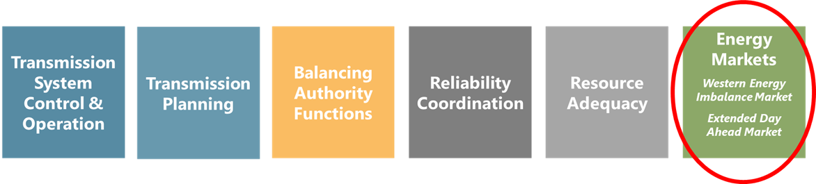
Pathways Expands Regional Coordination in Energy Markets But Leaves Other CAISO Functions Untouched

Slide 8
Pathways Initiative
Stepwise Process
Step 3
Step 2
Continue expanding the scope of regionalized functions and services offered by the Regional Organization
Step 1
Transfer governance authority over existing energy markets from CAISO to a new Regional Organization
Elevate WEIM/EDAM Governing Body authority in the governance of existing CAISO energy markets

Slide 9
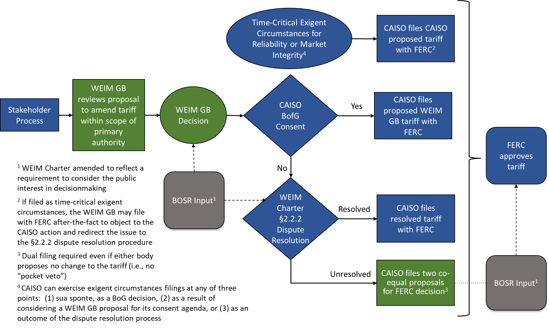
Step 1 Decisionmaking Process

Slide 10
Integration of Step 1 Comments
Key Changes
Expand responsibility of WEIM/EDAM Governing Body to respect both “state and local” policies
Highlight the existing right of WEIM Governing Body to commence a governance review in consultation with the CAISO Board in the event of EDAM exit by a substantial number of EDAM entities
Clarifications
  Operation of the dual filing/jump ball process
  Purpose and operation of the trigger
  Meaning of “exigent circumstances”
  Role of the Body of State Regulators
  “Applies to” test for determining the scope of Joint Authority
  Existing WEIM Charter §2.2.2 dispute resolution process

Slide 11
CAISO Step 1 Stakeholder Process/Timeline
On June 5, 2024, the Launch Committee of the Pathways Initiative submitted for consideration its Step 1 Recommendation to the ISO Board Chair Jan Schori and the WEIM Governing Body Chair Andrew Campbell.
The Chairs have directed management to initiate a stakeholder process to consider the recommendation and bring a proposal to the ISO Board and WEIM Governing Body to consider for a vote in mid to late September, 2024.
  Public stakeholder call June 18
  Written comments due July 10
Launch Committee will be involved, presenting the proposal during the public call and reviewing comments
  Encourage robust engagement from stakeholders during the comment period; offer support for additional meetings with stakeholders (potentially BOSR and RIF forums) as needed
Governance documents and tariff changes would be drafted and brought for decision at later date, closer to trigger being met

Slide 12
Step 2
Overview

Slide 13
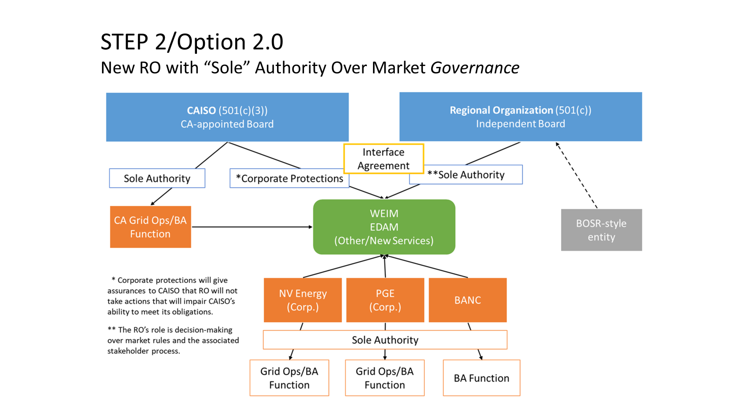

Slide 14
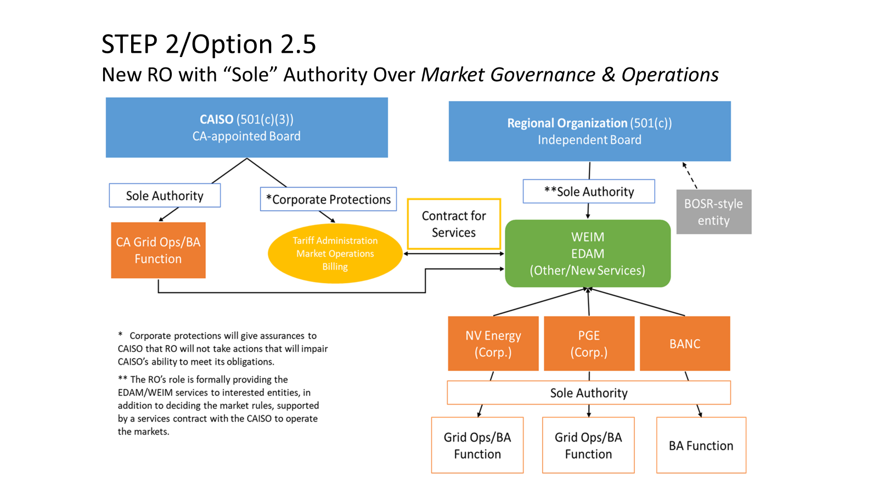

Slide 15
Phase II/Step 2
Work Plan and Timeline

Slide 16
Next Steps
Refine and finalize Step 2 with stakeholder workshops and collaboration with CAISO staff
Step 2 final recommendation: Sept./Oct.
Formation Committee to work on RO Initiation: Jan. - Sept. 2025
CA legislative engagement (ongoing): 2025 legislative session

Slide 17
Phase II Work Plan
Phase II of the Pathways Initiative will consist of refining the Step 2 proposal, and run from June-December 2024.
Step 2 has numerous open questions and remains under development as described in the straw proposal.
Step 2 Work Streams have been created, with two leads assigned to each, to address open issues.
Some topics will be addressed in public virtual workshops (topics and dates still under development) during the summer, open to all stakeholders.
The Stakeholder Process Work Stream will be addressed through an independently facilitated process to structure more opportunities for stakeholder participation.

Slide 18
Step 2 Work Streams and Leads
Stakeholder Process:
    Leads: Pam Sporborg and Kathleen Staks
      Example issues: policy topic framing, sector-based approaches
CAISO Issues:
    Leads: Spencer Gray and Evelyn Kahl
      Example issues: RO financial liability, contract privity
Existing Tariff Analysis:
    Leads: Tony Braun and Scott Ranzal
      Example issue: balancing authority function identification
Public Interest Issues:
    Leads: Carl Linvill and Kathleen Staks
      Example issue: BOSR evolution, consumer advocate participation
RO Formation:
    Leads: Lisa Hickey and Evelyn Kahl
      Example issue: form of incorporation
RO Governance:
    Leads: Jim Shetler and Jan Smutny-Jones
      Example issues: RO board nomination, RO funding source

Slide 19
Thank You.

